Slide 1


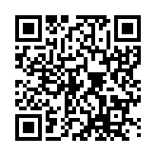
Russian Scholarship Project Association "Global Universities"
Open Doors
Olympiad competition winners will get a scholarship to study at
Bachelor’s degree
Master’s degree
Olympiad is held both in Russian and English
Olympiad competitions are held online
SIGN UP
Schedule of the Olympiad
First stage
5 September – 20 November
Portfolio
Winners of the 1st stage
Second stage
5 December – 10 December
Test
Results
10 January
Olympiad programs SFedU
Schedule on the website

Slide 2
Russian Scholarship Project Association "Global Universities"
Open Doors
Olympiad competition winners will get a scholarship for
PhD studies
Olympiad is held both in Russian and English
Olympiad competitions are held online
SIGN UP
Schedule of the Olympiad
First stage
5 September – 20 November
Portfolio
Winners of the 1st stage
Winners of the 2nd stage
Third stage
20 January –
20 February Interview
Second stage
5 December – 10 December
Test
Results
21 February
Academic supervisor SFedU
Schedule on the website

Slide 3

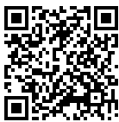
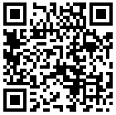
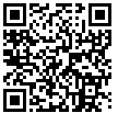
International Relation Office of Southern Federal University
105/42 Bolshaya Sadovaya Str., Rostov-on-Don, 344006, Russia
+7 (863) 218 40 24
welcome@sfedu.ru
Useful information
Student Leisure
Dormitory

